Slide 1






TRICKS OR TREATS?
What the Latest Legal Developments
Mean for Employers
A SEMINAR FOR EMPLOYERS by
October 26, 2017
www.amfdayton.com
© Auman, Mahan & Furry

Slide 2


TRICKS OF THE TRADE IN ELIMINATING PROBLEM EMPLOYEES
Exorcising Workplace Demons
Amy Mitchell
Board Certified Specialist
Labor and Employment Law
acm@amfdayton.com
(937) 223-6003

Slide 3
TRICKS OF THE TRADE
IN ELIMINATING PROBLEM EMPLOYEES
The Law Of The Vital Few
  80/20 Rule
    The 20%:
      Norman the Nonperformer
      Franky the FMLA Abuser
      Sabrina the Summer Vacationer
      Elvira the Always Equal Supervisor

Slide 4

NORMAN THE NONPERFORMER
Who Is Norman?
  Doesn’t fit in
  Below average performance
  Below average attendance
  Nothing egregious

Slide 5
NORMAN THE NONPERFORMER (continued)
At-Will Employment
But ...
  Title VII Of The Civil Rights Act
  Family And Medical Leave Act
  Age Discrimination In Employment Act
  Americans With Disabilities Act
  Ohio Revised Code Chapter 4112
  National Labor Relations Act
  Occupational Safety & Health Act
  Veterans Re-employment
  Act (USERRA)
  Equal Pay Act
  Whistleblower’s Protection Act
  Fair Labor Standards Act
  Workers’ Compensation Act
  Fair Credit Reporting Act

Slide 6
NORMAN THE NONPERFORMER (continued)
Jury Awards $31.2 Million To Wal-Mart Pharmacist In Her Action For Gender Discrimination
$2.2 Million Verdict In Male Truck Driver’s Sexual & Race Harassment Case (Including Damages Against Individual Supervisors)
Court Upholds Jury Verdict Including $50,000 In Punitive Damages In “Instagram Planet Of The Apes” National Origin Discrimination Case

Slide 7
NORMAN THE NONPERFORMER
Tricks of the Trade
Utilize Progressive Discipline
  Include consequences “up to and including termination”
  Include specifics on poor performance
  Include general requirements to abide by all company policies and/or job description
Challenge Supervisors
  Is there a “real” story

Slide 8
NORMAN THE NONPERFORMER
Tricks of the Trade (continued)
Do Not Pass Up Windows Of Opportunity
Provide Norman The Opportunity To Explain
Consider Proper Person To Make The Decision To Terminate
  Previous inappropriate/discriminatory statements
  Same actor inference

Slide 9
NORMAN THE NONPERFORMER
Tricks of the Trade (continued)
Document Decision In Deferred Terminations
Consider Timing And Manner Of Termination
Offer Option To Resign
Consider Use Of Severance Agreements

Slide 10
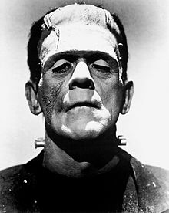
FRANKY THE FMLA ABUSER
Who Is Franky?
  Migraines
  Intermittent FMLA
  4-6 days each month
  Flare-ups
    Often takes leave when assigned projects he does not like or on Mondays, or
    Announces the posted schedule does not apply to him because of FMLA

Slide 11
FRANKY THE FMLA ABUSER (continued)
Family and Medical Leave Act
  12 weeks (26 for military) of unpaid leave
    Continuous or intermittent leave
  Eligible Employee
    12 months/1250 hours
      12 months does not need to be consecutive
  Covered Employer
    50 employees for 20 weeks/75 mile radius

Slide 12
FRANKY THE FMLA ABUSER (continued)
Serious Health Condition
  An illness, injury, impairment or physical or mental condition that involves inpatient care or continuing treatment by a health care provider
    Continuing treatment
      Incapacity of 3+ days
        Incapacity is the inability to work, attend school or perform other regular daily activities
      Treatment required:
        2 or more in-person visits within first 30 days of incapacity with first in-person visit in first 7 days
        1 in-person visit w/treatment within first 7 days plus a regimen of continuing care (prescription medication, physical therapy, etc.)

Slide 13
FRANKY THE FMLA ABUSER (continued)
Chronic Conditions
  Require periodic visits and caused episodic rather than continuing period of incapacity (asthma, diabetes, epilepsy, etc.)
Pregnancy/Prenatal Care (Severe Morning Sickness)
Permanent Or Long-term Conditions (Stroke, Alzheimer’s)
Conditions Requiring Multiple Treatment And Recovery (Cancer, Severe Arthritis, Kidney Disease)
Treatment For Substance Abuse

Slide 14
FRANKY THE FMLA ABUSER (continued)
Conditions Which Are NOT Serious Health Conditions Unless Complications:
  Cosmetic treatments
  Common cold
  Ear ache
  Upset stomach
  Minor ulcers
  Headaches other than migraines
  Routine dental care

Slide 15
FRANKY THE FMLA ABUSER
Tricks of the Trade
Require Initial Medical Certification and Carefully Analyze Forms
  Must request first certification in writing
  Employee has 15 days to complete
  Sufficient and complete?
    Clarification – HR only
  Analyze whether the condition meets the definition of serious health condition
    Consider a second/third opinion – Reason to Doubt
  Approve only for the amount of time requested
  Understand liability for TPA’s actions

Slide 16
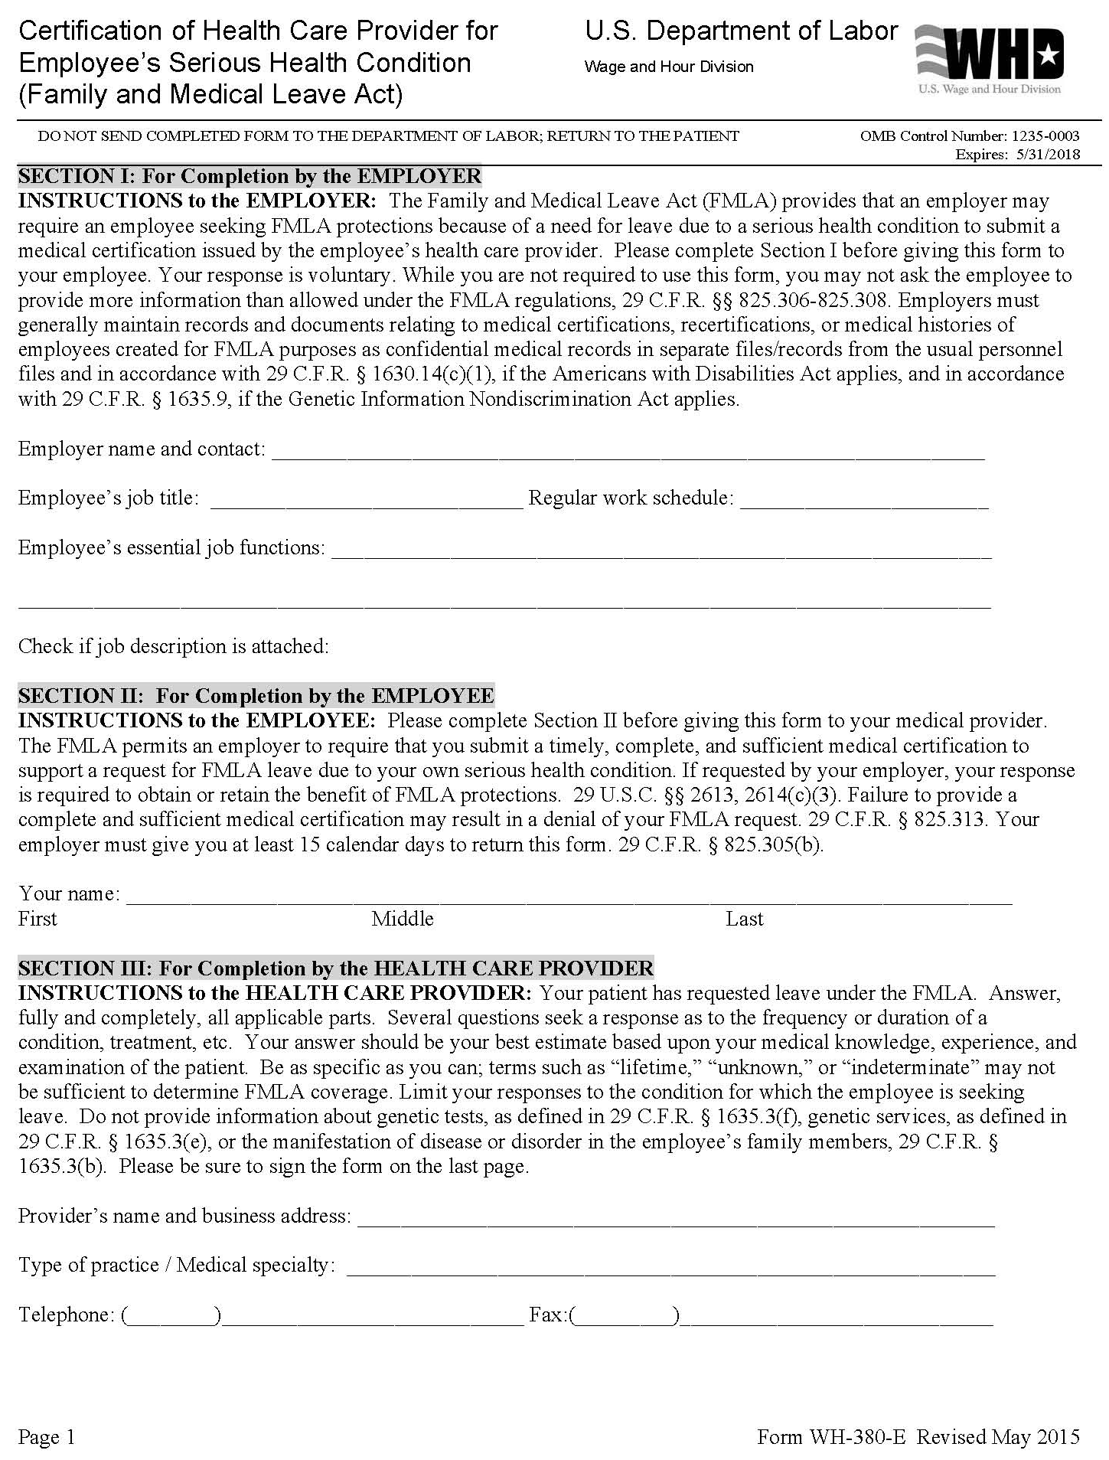
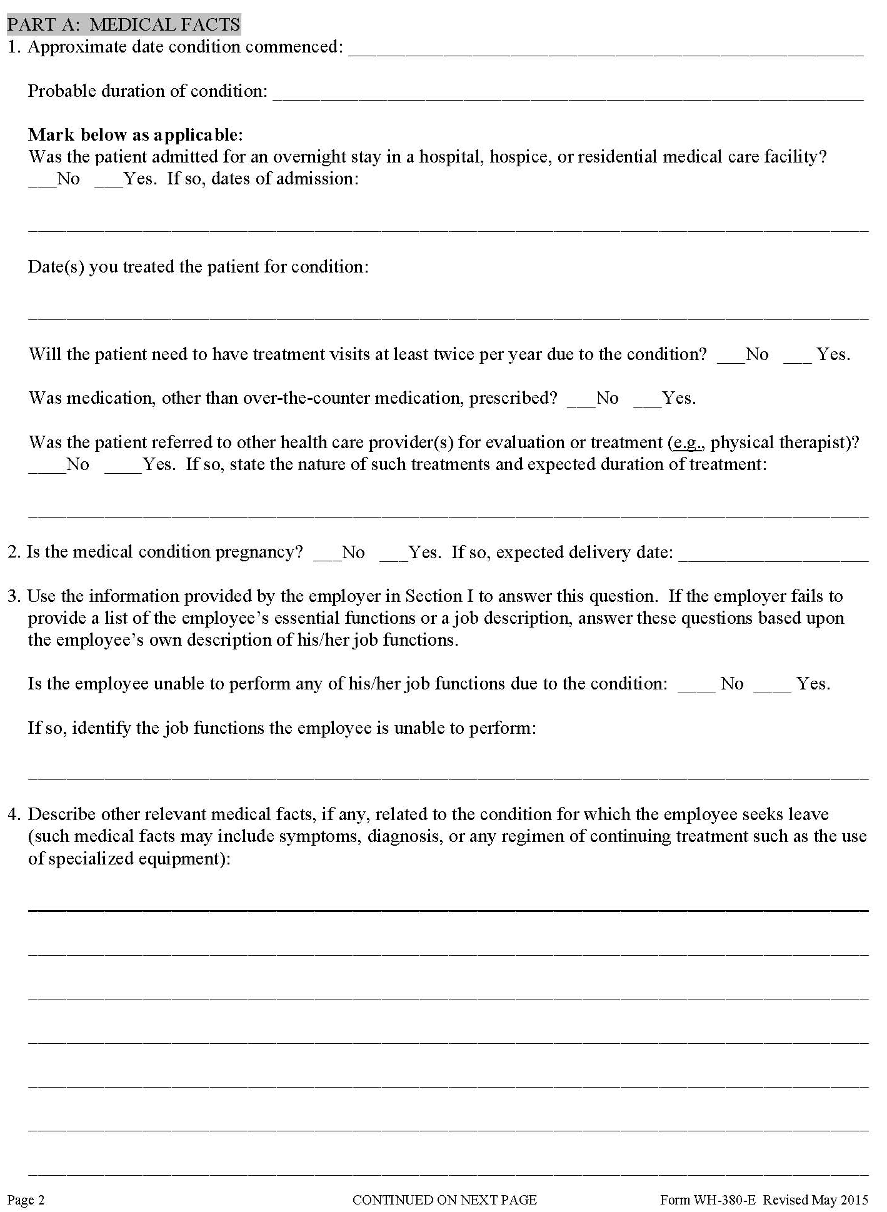

Slide 17
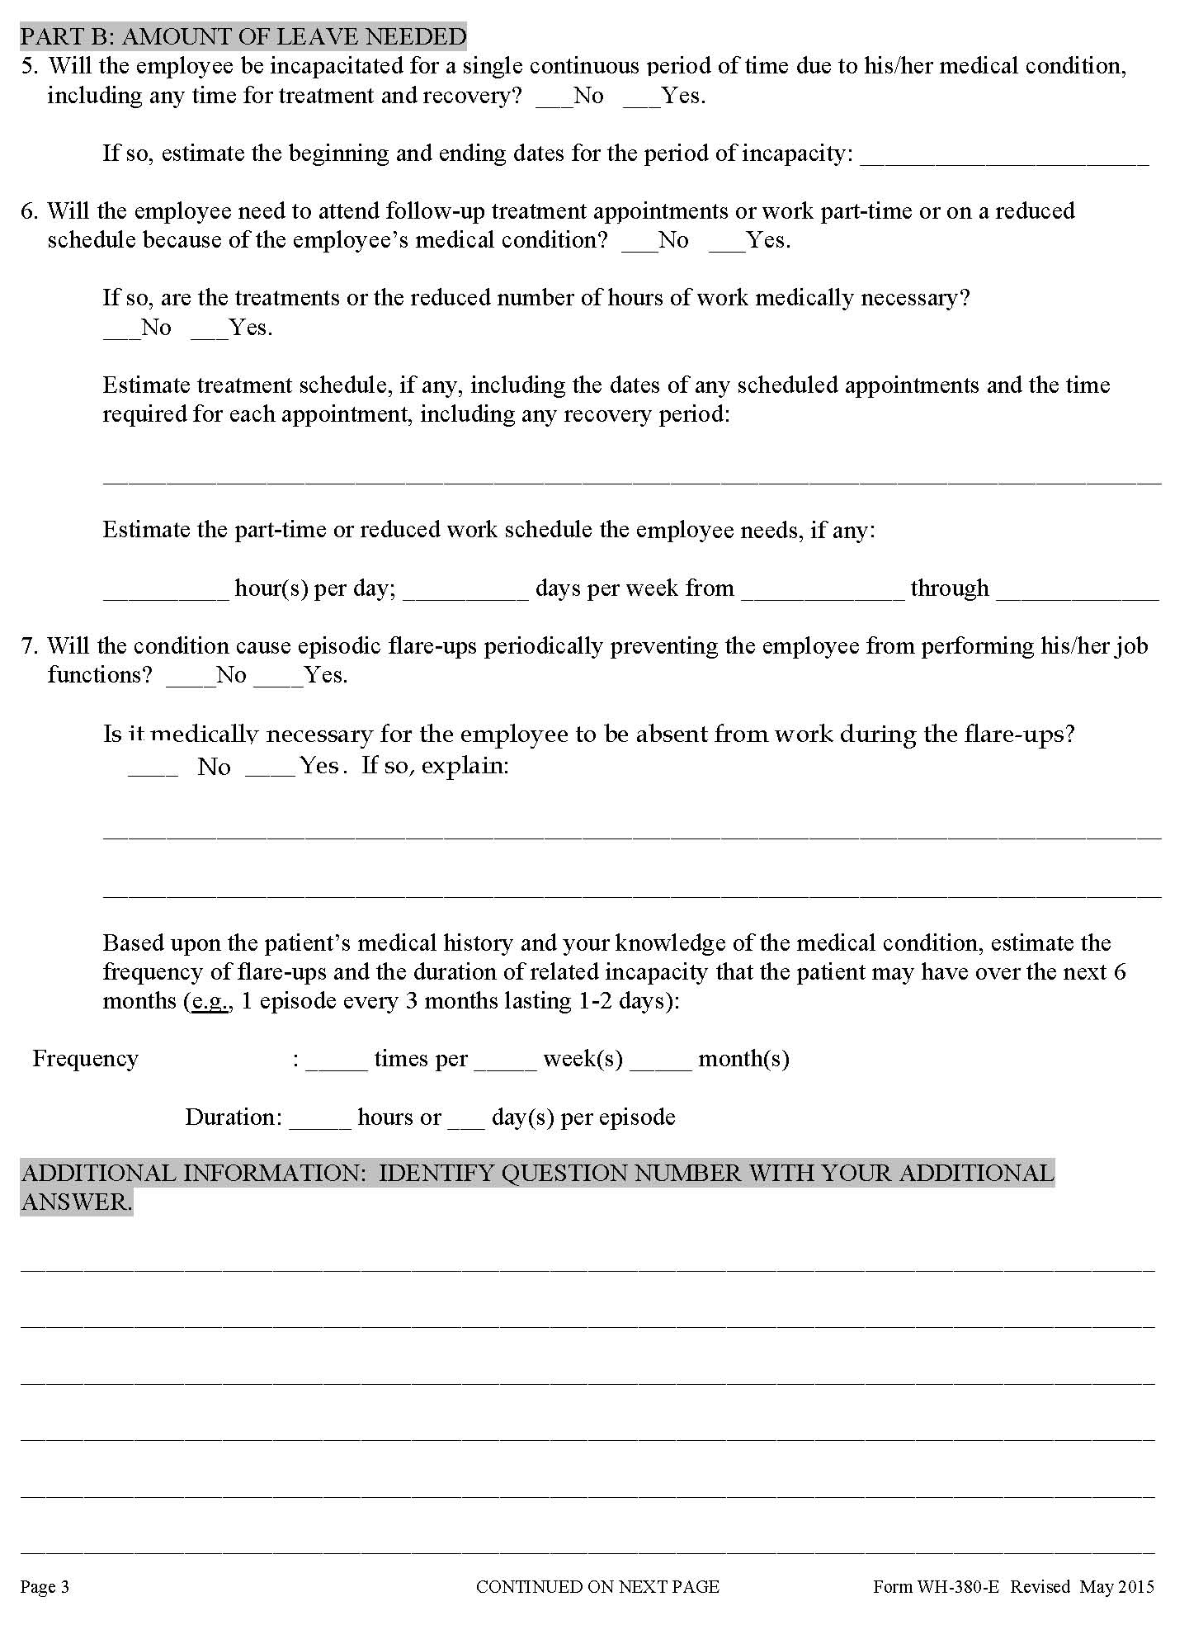
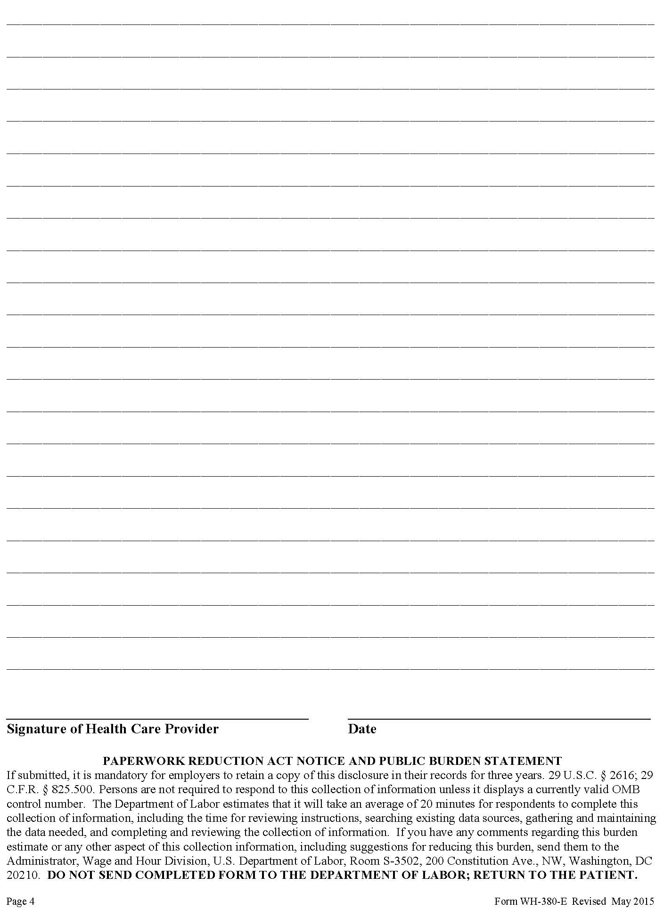

Slide 18
FRANKY THE FMLA ABUSER
Tricks of the Trade (continued)
Require Recertification
  Every 6 months if condition lasts longer than 30 days in connection with absence
  Or
  Circumstances have changed (duration and frequency of absences)
  Or
  Employer receives information that casts doubt on stated reason for absence
  No 2nd or 3rd opinions on Recertification

Slide 19

FRANKY THE FMLA ABUSER
Tricks of the Trade (continued)
Require Annual Certifications
  12 months after FMLA began for specific condition
  Analyze forms
    Has the employee visited the physician
  May require 2nd and 3rd opinions

Slide 20
FRANKY THE FMLA ABUSER
Tricks of the Trade (continued)
Consider Reassignment If Planned Leave Or Reduced Schedule Leave
Carefully Designate And Use Retroactive Designation When Possible To Exhaust FMLA
Revise FMLA Policy
  Require use of paid time off
  Prohibit work and travel during FMLA leave

Slide 21


FRANKY THE FMLA ABUSER
Tricks of the Trade (continued)
Investigate Absences/ Establish Good Faith Belief
  Surveillance and/or Facebook/Twitter
Provide Employee Chance To Explain
Terminate For Lying/Violation Of Policy
Actual firing Facebook photo

Slide 22

SABRINA THE SUMMER VACATIONER
Who Is Sabrina?
  Depression/Anxiety/
  Arthritis/Back Pain
  Exhausted Or Not Eligible For FMLA
  Requests leave every summer

Slide 23
SABRINA THE SUMMER VACATIONER (continued)
Americans with Disabilities Act of 1990 and ADA Amendments Act of 2008
  Requires employers to provide Reasonable Accommodations to Qualified Individuals with Disabilities
  Disability under the ADA is broad
    a physical or mental impairment that substantially limits one or more major life activities
    a record of such an impairment
    regarded as having an impairment

Slide 24
ADA
Physical Or Mental Impairment
  any physiological disorder, or condition, cosmetic disfigurement, or anatomical loss affecting one or more of the following body systems: neurological, musculoskeletal, special sense organs, respiratory, cardiovascular, reproductive, digestive, genitourinary, hemic and lymphatic, skin and endocrine; or any mental or psychological disorder, such as mental retardation, organic brain syndrome, emotional or mental illness, and specific learning disabilities

Slide 25
ADA (continued)
Diabetes
Cancer
Epilepsy
Intellectual Disabilities
Partial or Completely Missing Limbs
Mobility Impairments
Autism
Cerebral Palsy
Multiple Sclerosis
Muscular Dystrophy
Major Depressive Disorder
Bipolar Disorder
Post-Traumatic Stress Disorder
Obsessive-Compulsive Disorder
Schizophrenia

Slide 26
ADA (continued)
Reasonable Accommodation
  Unpaid leave?
    Yes
  Unpaid leave after FMLA exhausted?
    Usually
  Unpaid leave for more than 6 months?
    Sometimes
  Unpaid leave for indefinite period of time?
    No

Slide 27
SABRINA THE SUMMER VACATIONER
Tricks of the Trade
Use The Interactive Process
  Ask for written documentation of request for leave
  Seek clarification of request if unclear
  Ask for treating physician’s opinion as to nature and severity of condition (Qualified?)
  Ask whether employee will be able to return to position
  Ask whether any other accommodations will allow the employee to return to work
  Ask whether restrictions are permanent
  Ask whether length of leave requested is definite or indefinite
  Require explanation of extensions and why prior RTW date was not accurate

Slide 28
SABRINA THE SUMMER VACATIONER
Tricks of the Trade (continued)
Document, Document, Document!
  Length of leave approved
  The date the employee is required to contact Employer with status/RTW
  Requirement of release to RTW from physician
  Undue hardship to grant leave
Letter To Employee Upon Termination
  Detail length of leave granted and extensions
  Detail finding of indefinite leave or permanent restrictions that cannot be accommodated
  Inform employee she can apply for employment for open positions when able to return to work

Slide 29

ELVIRA THE EQUAL
OPPORTUNITY SUPERVISOR
Who Is Elvira?
  Long time supervisor
  Strictly enforces all rules
  Makes no exceptions
  Does not tolerate complainers

Slide 30
ELVIRA THE EQUAL
OPPORTUNITY SUPERVISOR (continued)
Why Is Elvira A Problem?
  ADA
    Preferential Treatment Required
    Complaints may be requests for accommodation
      “I cannot work on this computer because the monitor triggers my migraines”
  Section 7 of the National Labor Relations Act
    Union or non-union
    Protected, Concerted Activity
      Terms and conditions
      “[Elvira] is such a NASTY MOTHER F***ER don’t know how to talk to people!!!!!! F**k his mother and his entire f**king family!!!! What a LOSER!!!! Vote YES for the UNION!!!!!!!”

Slide 31
ELVIRA THE EQUAL
OPPORTUNITY SUPERVISOR
Tricks of the Trade
Train Elvira
  Harassment/discrimination
  Supervisor liability
  Progressive discipline and documentation
Require HR Involvement
Ensure Policies In Employee Handbook Match Workplace Policies And Practices
Legal Review Of Employee Handbook

Slide 32

NON-COMPETES, NON-SOLICITATION AND CONFIDENTIALITY AGREEMENTS
Phantom or Real:
How Enforceable Are They?
Matthew Bakota
Certified Professional in Human Resources (PHR)
Licensed Attorney in Ohio and Kentucky
mjb@amfdayton.com
(937) 223-6003

Slide 33
OVERVIEW
Types of Restrictive Covenants
Enforcing Your Own Covenants
  How enforceable are they?
  Investigating suspected violations
  Pursuing violators
Employees Bound By Others’ Covenants
  Do you want to know?
  Best practices when you have notice
Key Takeaways

Slide 34
TYPES OF RESTRICTIVE COVENANTS
Non-Competes
  Type of work
  Geographic area
  Time period
Non-Solicitation
  Employees
  Customers
Confidentiality

Slide 35


ENFORCING YOUR OWN COVENANTS
Q: How enforceable are they?
A: It depends . . .

Slide 36
ENFORCING YOUR OWN COVENANTS (continued)
Non-Competes
  The Raimonde Rule (from the case law)
    Enforced to the extent necessary to protect employer’s legitimate business interests
    Can be modified to limit “unreasonable” restrictions, instead of just not enforcing them at all
  The Golden Rule (from experience)
    Chances of enforcement are as good as the judge you draw
Activity-Based Covenants
  Similar, but not the same

Slide 37
ENFORCING YOUR OWN COVENANTS
(continued)
What Judges Typically Want To See
  Signed agreement, with consideration for covenant
  “Good” facts
    Valuable employee w/knowledge, training & experience
    Knowledge of protected information
    Unfair competition
    Risks of specific harm
  “Ideal” facts
    Pre-planning by violator
    Evidence of collusion / knowledge by new employer
    Specific harm already incurred

Slide 38

ENFORCING YOUR OWN COVENANTS
(continued)
Potential “Case Killers”
  Mistakes in contract process
  Delay / prior waiver
  Failure to protect confidential information
  Involving new employer
  Failure to assess opponent
  Failure to take advantage of other venue options . . . such as federal court

Slide 39

ENFORCING YOUR OWN COVENANTS
(continued)
Investigating Suspected Violations
  Go “undercover”
  Consider all available tools
    But be careful → → →
    “Is this a good idea?”
  Preserve evidence
Pursuing Violations
  Creative solutions to avoid litigation
  Litigation: when? where? (federal court?)

Slide 40
EMPLOYEES & OTHERS’ COVENANTS
Do You Want To Know?
  Pros:
  Avoid legal liability
  Cost-benefit analysis
  Avoid waste of time & resources
  Cons:
  Knowledge = risk of legal liability
  Lost opportunity of a good worker

Slide 41
EMPLOYEES & OTHERS’ COVENANTS
(continued)
Best Practices When You Have Notice
  Carefully consider your communications
  Get counsel involved
  Analyze your opponent(s)
  Perform a risk-benefit analysis
    Risks may change
    Update your analysis as the matter progresses

Slide 42
KEY TAKEAWAYS…
Be Strategic When Drafting Your Covenants And Obtaining Employees’ Agreement To Same
Protect Your Confidential Information
If You Suspect A Violation, Start Building Your Case Early And Carefully
Always Consider Venue And Judge When Deciding Whether To Pursue Litigation
Avoid The “Case Killers”
Don’t Underestimate The Opposition

Slide 43
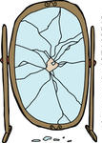

WORKPLACE SAFETY LAW UPDATE
Black Cats, Broken Mirrors and Other Safety Issues
Abigail White
akw@amfdayton.com
(937) 223-6003

Slide 44

OSHA
Electronic Reporting

Slide 45

OSHA
Electronic Reporting
29 CFR 1904.41
Effective January 1, 2017
Enforced Starting December 1, 2027
Certain Employers Will Report Illness And Injury Data To OSHA
Information To Be Made Publicly Available On OSHA’s Website

Slide 46
OSHA
Electronic Reporting (continued)
Submission Year | 250 or more Employees | 20-249 Employees in “high risk” industry | Submission Deadline
2017 | Form 300A | Form 300A | December 1, 2017
2018 | Forms 300A, 300 & 301 | Form 300A | July 1, 2018
2019 & to continue | Forms 300A, 300 & 301 | Form 300A | March 2, 2019

Slide 47
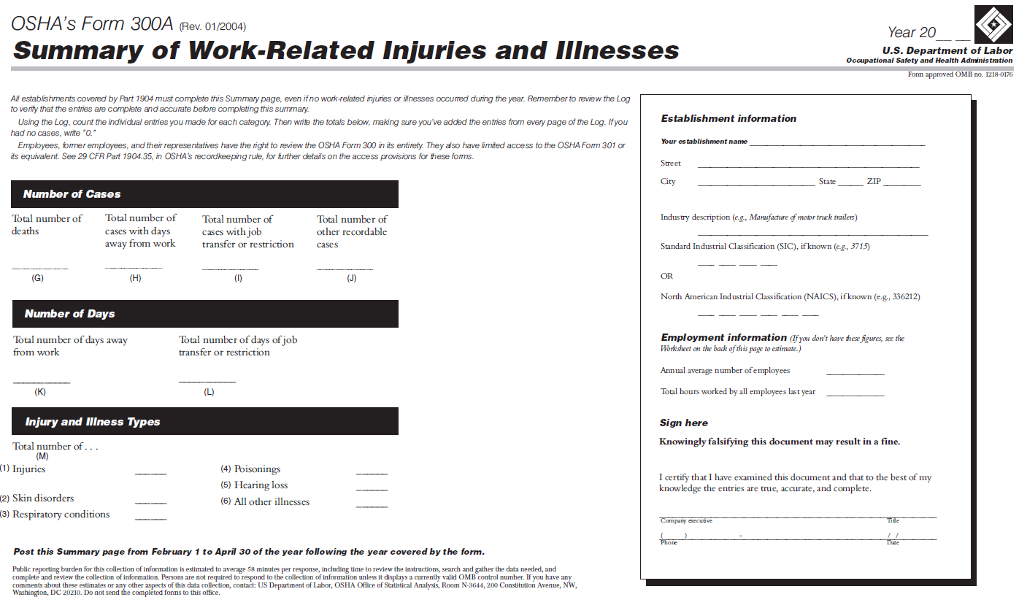
OSHA
Electronic Reporting (continued)

Slide 48
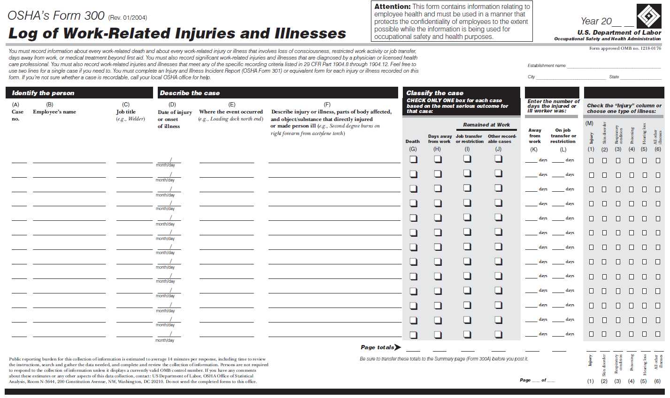
OSHA
Electronic Reporting (continued)
Form 300

Slide 49
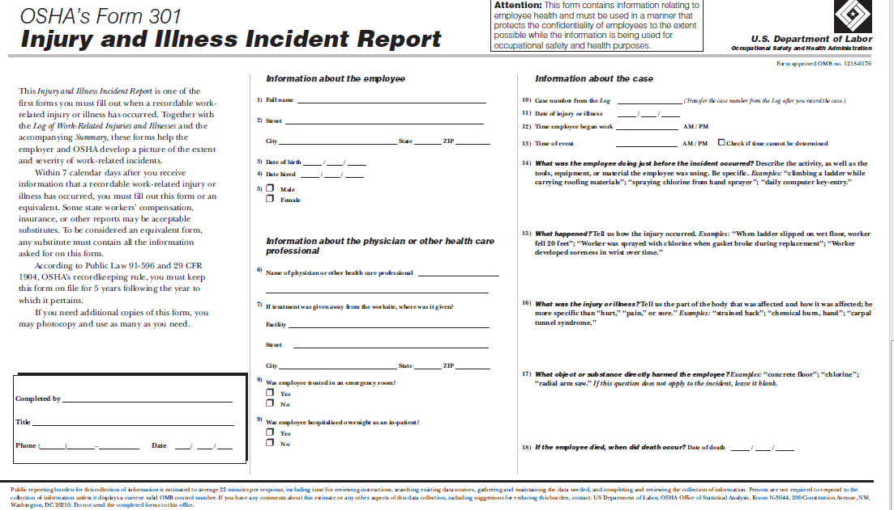
OSHA
Electronic Reporting (continued)

Slide 50
OSHA
Electronic Reporting (continued)
Employee Count: By Establishment, Not By Firm
Establishment: “a single physical location where business is conducted or where services or industrial operations are performed”
Employee Count: Peak Employment During Last Calendar Year

Slide 51

OSHA
Anti-Retaliation

Slide 52
OSHA
Anti-Retaliation (continued)
29 CFR 1904.35
Prohibits Employers From Taking Any Action That Would Discourage Workers From Reporting An Injury Or Illness
Enforcement Started Dec. 1, 2016

Slide 53
OSHA
Anti-Retaliation (continued)
Inform All Employees Of Their Right To Report Work-Related Injuries And Illnesses Free From Retaliation
Implement Reasonable Procedures For Reporting Work-Related Injuries And Illnesses
Do Not Retaliate Against Employees In Any Way For Reporting Injuries And Illnesses

Slide 54
OSHA
Anti-Retaliation (continued)
Forms of Retaliatory Conduct:
  Mandatory Post-Injury Drug Testing
  Disciplining Employee For Reporting An On-The-Job Injury (Filing A W/C Claim)
  Disciplining Employee For Not Following The Rules For Reporting An On-The-Job Injury
  Incentive Programs Tied Into Injury Reporting
  Having Complex, Difficult To Understand Procedures For Employees To Follow To Report On-The-Job Injuries
  Disciplining An Employee For A Safety Violation Which Resulted In An On-The-Job Injury

Slide 55
OSHA
Anti-Retaliation (continued)
11(c) vs. 1904.35
11(c) Used To Be The Only Avenue For Retaliation Claim
Now, OSHA Can Actually Come Out And Cite You For This, Just Like Any Other Safety Violation

Slide 56

OSHA
Respirable Crystalline Silica

Slide 57
OSHA
Respirable Crystalline Silica (continued)
Examples:
  Sand
  Stone (ex. Quartz)
  Concrete
  Mortar
  Glass
  Bricks
  Artificial stone
  Industrial sand used in certain operations, such as foundry work

Slide 58
OSHA
Respirable Crystalline Silica (continued)
Effective Date – June 23, 2016
Enforcement Date:
  Construction industry: September 23, 2017
  General industry: June 23, 2018 (most provisions)

Slide 59
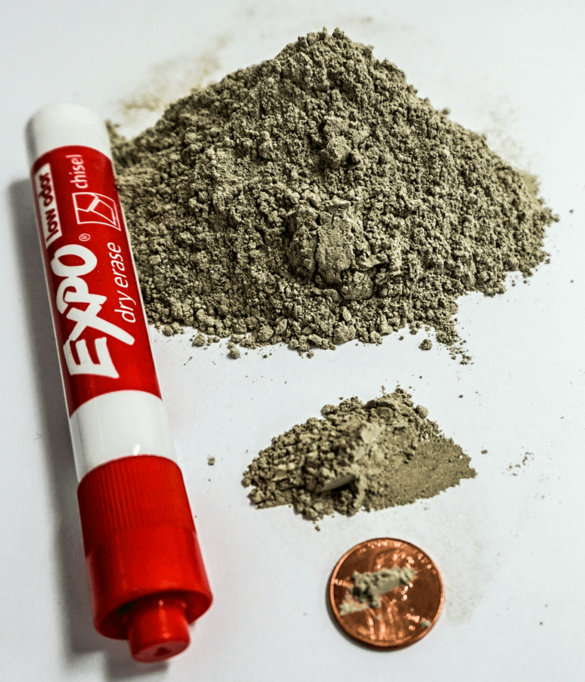
OSHA
Respirable Crystalline Silica (continued)
New PEL 50 µg/m³
(this is about 20% of the old PEL)
New Action Level 25 µg/m³

Slide 60
OSHA
Respirable Crystalline Silica (continued)
If You Meet The Action Level (25µg/m³)
  Construction Industry
    Use a control method recommended in Table 1 (easiest); OR
      lists common construction tasks (ex. handheld power saws) and matches task with dust control methods, so you know exactly what you need to do to limit exposure
    Perform exposure air monitoring and protect workers exposed above the PEL (50 µg/m³) with dust controls and respirators
  General Industry
    Table 1 does not apply
    Perform exposure air monitoring and protect workers exposed above the PEL with dust controls (first) and respirators (second)

Slide 61
OSHA
Respirable Crystalline Silica (continued)
  Both Construction and General Industry:
    Restrict housekeeping practices that expose workers to silica
    Establish a written exposure control plan
    Offer medical exams
    Training
    Recordkeeping

Slide 62
OSHA
Respirable Crystalline Silica (continued)
Employee Training:
  Health hazards associated with exposure to respirable crystalline silica
  Specific tasks in workplace that could result in exposure
  Specific measures implemented by employer to protect employees from exposure
  Contents of the standard
  Purpose and description of medical surveillance program

Slide 63
OSHA
Respirable Crystalline Silica (continued)
Recordkeeping:
Air monitoring data
All objective data relied on for compliance
Medical surveillance

Slide 64
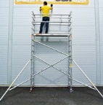
OSHA
Walking-Working Surfaces

Slide 65
OSHA
Walking-Working Surfaces (continued)
New Standard For General Industry
Effective January 17, 2017 (Most Provisions)
OSHA Essentially Copied The Construction Standards For Walking And Working Surfaces Into The General Industry Standards
Includes Standards For Fixed Ladders; Rope Descent Systems, Fall Protection, And Scaffolds
Adopts And Incorporates The Construction Scaffold Standard (1926 Subpart L) By Reference

Slide 66
CHANGES TO OHIO WORKERS’ COMPENSATION LAW
Sub. H.B. 27
Effective 9/29/17

Slide 67
SUB. H.B. 27
Statute Of Limitations For Filing Claim
Now One Year From Date Of Injury
Used To Be Two Years
For Dates Of Injury 9/29/17 And After

Slide 68
SUB. H.B. 27
Court Appeals
Previously: 60 Days To File A Court Appeal
Deadline To Appeal Can Now Be Extended To 150 Days If Either Claimant Or Employer Files A Notice Of Intent To Settle
File Intent To Settle Within 30 Days
Opposing Party Has 14 Days To Object

Slide 69
SUB. H.B. 27
Statutory Attorney’s Fees
Fees Paid To Claimant’s Attorney If Claimant Wins Court Appeal
Used To Be $4,200
Increased To $5,000
Paid By The Employer If The Employer Contested The Claimant’s Right To Participate

Slide 70
SUB. H.B. 27
Handicap Reimbursement
Handicap Reimbursement: Portion Of Claim Costs Are Refunded To Employer’s Policy, If Claimant Suffers From Condition(s) Specified By Statute
Ex. Epilepsy, Diabetes, Cardiac Disease, Arthritis, Etc.
Now, Settlements Treated As “Compensation”, And Handicap Reimbursement Will Be Applied To Settlement As Well

Slide 71
SUB. H.B. 27
Other Changes
Drug Testing: Threshold Values Of Controlled Substances Now Tied To Federal DOT Cutoff Concentration Levels (49 C.F.R. 40.87)
BWC 90 Day Exam: Employers Can Now Object To BWC’s Waiver Of The 90 Day Exam
PPD Awards: BWC Will Dismiss A PPD Application (Rather Than Suspend It), If Claimant No-Shows For Two Exams
FWW: If Employee Eligible For Compensation But FWW Has Not Been Determined, Will Receive 33 1/3% Of Statewide AWW Until FWW Is Determined. Then Overpayment/Underpayment Will Be Assessed

Slide 72


EMPLOYMENT LAW UPDATE IN AN EVER-CHANGING ENVIRONMENT
Tricks, Treats, or Grab Bag
Steve Watring
Board Certified Specialist
Labor and Employment Law
saw@amfdayton.com
(937) 223-6003

Slide 73

“Misinformation followed us like a plague
Nobody knew from time to time
If the plans were changed.”
Peace Like a River, Paul Simon

Slide 74
“This was not the plan!”
Lynn Rhinehart, General Counsel, AFL-CIO

Slide 75
NATIONAL LABOR RELATIONS BOARD

Slide 76
NATIONAL LABOR RELATIONS BOARD
(continued)
The Way It Works
  5 Board seats
    2 appointees from opposing party
    3 appointees from President’s party
    Chairman decides what cases to take in what order

Slide 77
NATIONAL LABOR RELATIONS BOARD
(continued)
  1 General Counsel
    Appointed from President’s party
    Decides what cases to prosecute
    Issues advice memoranda

Slide 78
NATIONAL LABOR RELATIONS BOARD
(continued)
  Vacancy upon term expiration/resignation
  Appointments subject to Senate confirmation
  Most decisions by 3 member panel
  Many decisions of “Obama Board” 2-1
  Most “law” by decision rather than regulation

Slide 79
NATIONAL LABOR RELATIONS BOARD
(continued)
Where We Stand Today
  General Counsel change expected November 4
  Full “Trump Board” now in place
    The minority has now become the majority

Slide 80
NATIONAL LABOR RELATIONS BOARD
(continued)
What To Expect – Back To The Past
  Sweeping changes over last nine years
  Sweeping reversal of course expected

Slide 81
NATIONAL LABOR RELATIONS BOARD
(continued)
Key Changes Expected Soon
  Employment policies/handbooks/discipline
    Confidentiality of information
    Confidentiality of investigations
    Employee statements on social media/internet
    Insubordinate and disrespectful statements
    Disparaging statements to customers
    Discriminatory and harassing behavior

Slide 82
NATIONAL LABOR RELATIONS BOARD
(continued)
Key Changes Expected Soon (continued)
  Use of employer email system for protected concerted activity
  In-store picketing in front of customers
  Joint employer-direct control or potential control
  Erosion of management rights clauses

Slide 83
NATIONAL LABOR RELATIONS BOARD
(continued)
Key Changes Expected Later
  Ambush elections
The Dallas Cowboys
  Is kneeling protected concerted activity?

Slide 84

NATIONAL LABOR RELATIONS BOARD
(continued)
What To Do Now
  Stay the course on policies
  Be cautious on discipline
  Don’t be the next lead case
  PIONEERS TAKE THE ARROWS!

Slide 85
DEPARTMENT
OF LABOR

Slide 86
DEPARTMENT OF LABOR (continued)
The Way It Works
  President appoints top positions
    Secretary of Labor
    Deputy Secretary
    Wage and Hour Administrator
    Numerous Assistant Secretaries/Others
  Almost always from President’s party
  Appointments subject to Senate confirmation

Slide 87
DEPARTMENT OF LABOR (continued)
Where We Stand Today
  Trump’s Secretary of Labor confirmed
  That’s it!

Slide 88
DEPARTMENT OF LABOR (continued)
What To Expect – Back To The Drawing Board

Slide 89
DEPARTMENT OF LABOR (continued)
  New Salary Test for Exempt Employees
    Change from $455 a week to $913 a week
    Court enjoins before takes effect
    Election of Trump places in limbo
    Regulation being revisited
    New compromise regulation likely

Slide 90
DEPARTMENT OF LABOR (continued)
  New Salary Test for Exempt Employees (continued)
    What to do now
      Current employees
        Stay the course
      New hires – less than $913 weekly
        Pay hourly or
        Plan for possible conversion to hourly

Slide 91
DEPARTMENT OF LABOR (continued)
OSHA: Post Accident Drug Testing As Illegal Retaliation For Reporting Injury Or Illness
Question:
  May an employer require post-incident drug testing for an employee who reports a workplace injury or illness?

Slide 92
DEPARTMENT OF LABOR (continued)
Answer (or why people HATE lawyers):
  The rule does not prohibit drug testing of employees. It only prohibits employers from using drug testing, or the threat of drug testing, as a form of retaliation against employees who report injuries or illnesses. If an employer conducts drug testing to comply with the requirements of a state or federal law or regulation, the employer's motive would not be retaliatory and this rule would not prohibit such testing.

Slide 93
DEPARTMENT OF LABOR (continued)
What To Do
  If possible, bolster post-accident drug testing with reasonable suspicion
  If not possible, balance risk-reward of testing
  Remember
    Employee that complains will have tested positive
    Positive test validates questionable reasonable suspicion

Slide 94
DEPARTMENT OF LABOR (continued)
What To Expect – Stick A Fork In It
  DoL Union-Aversion Persuader Rules
  DoL wage-hour interpretation expanding joint employer definition
  DoL wage-hour interpretation restricting independent contractor use
  Fair Pay and Safe Work Places Executive Order

Slide 95
DEPARTMENT OF LABOR (continued)
What To Expect – Alive For Now?
  Federal contractors
    $10.10 minimum wage
    Mandatory paid sick leave
    Encouragement of project labor agreements
    Non-retaliation for disclosure of compensation

Slide 96
DEPARTMENT OF LABOR (continued)
What To Do Now
  Plan for no change
  Hope for change

Slide 97
NEW REPORTING AND
DISCLOSURE OBLIGATIONS
Revised I-9 Forms – Must Be Used Commencing September 18, 2017
New EEO-1 Form Requiring Wage Data Suspended
  Reporting deadline now March 31
NLRB Rights Poster

Slide 98
DREAMERS – DREAM ON
Dreamers Likely Here To Stay
Comply For Today
Plan For Tomorrow

Slide 99
EQUAL EMPLOYMENT OPPORTUNITY COMMISSION

Slide 100
EQUAL EMPLOYMENT
OPPORTUNITY COMMISSION (continued)
Where We Stand Today
  5 Commission Seats
    Chairman – Trump appointee
    3 members – Obama appointees
      1 until new appointee confirmed
    1 vacant seat
    Change of control on the horizon

Slide 101
EQUAL EMPLOYMENT
OPPORTUNITY COMMISSION (continued)
What To Expect – Back To The Past II
  Key Policy Changes Expected Soon
    LGBTQ Coverage
    Pay Equity
    Immigrant Protection
    Wellness Programs

Slide 102
THE SUPREMES

Slide 103


Slide 104
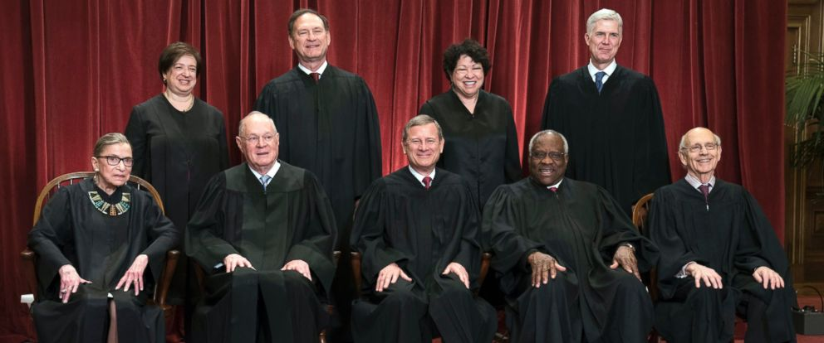
No, I meant these Supremes ...

Slide 105
THE COURT TODAY
4 Progressives
  One 84/One 79
4 Conservatives
  Oldest 69
1 Swing – Kennedy – 81
  Expected to retire
  Would be replaced by conservative

Slide 106
SUPREME COURT IMPACT ON EMPLOYMENT LAW
LGBTQ Issues
  Issue-Protection under Title VII
  Advice
    Avoid discrimination
    Amend EEO policy?

Slide 107
SUPREME COURT IMPACT ON EMPLOYMENT LAW (continued)
Religious Freedom
  Non-employment cases
  Advice
    Watch list item in multi-cultural workplace

Slide 108
SEE YOU IN COURT
Judicial Activism On Steroids
  Rampant judge shopping
  Injunctions the order of the day
What To Do
  Plan for compliance
  Delay implementation

Slide 109
REGULATING THE REGULATORS
The “4th Branch of Government” Under Fire
  Trump sets two for one repeal-enactment ratio
  Congress repeals regulations under Congressional Review Act
  Supreme Court may limit judicial deference

Slide 110
OHIO LAW
UPDATE

Slide 111
EMPLOYEE MARIJUANA USE
Where We Stand Today
  Federal law prohibits any marijuana use or possession
  Ohio law permits medical marijuana use
    Employers can still discharge for

Slide 112
EMPLOYEE MARIJUANA USE (continued)
What To Do
  Safest to still cover medical marijuana in policy
  Most employers can choose to exclude
    Exceptions – DoT, government contractors, BWC discount program
  Check with your Medical Review Officer

Slide 113
EMPLOYEE CONCEALED CARRY RIGHTS-effective 3-31-17
Employer Cannot Prohibit Permit Holder From Transporting/Storing Firearms/Ammunition Inside Their Privately Owned Motor Vehicle
  While permit holder is physically present in vehicle or,
  While firearm/ammunition is locked within the trunk/glove box/enclosed container/ compartment if:
  Vehicle in location where it is permitted to be

Slide 114
EMPLOYEE CONCEALED CARRY RIGHTS-effective 3-31-17 (continued)
Where Things Stand
  Law does not currently contain any express enforcement mechanism/remedy
  Employee discharged in violation of law probably has wrongful termination claim
  Permit holders that carry likely to know their rights

Slide 115
EMPLOYEE CONCEALED CARRY RIGHTS-effective 3-31-17 (continued)
What To Do
  Resistance is futile
  Just maintaining policy unlikely to create legal problems
  Employees likely to keep firearms in car anyway

Slide 116
OTHER OHIO LAW DEVELOPMENTS
2018 Minimum Wage Increase
  $8.15 to $8.30
Private Statute of Limitations Upheld
  Employment application

Slide 117
ON THE HORIZON
Companion Animals At Work
Employee Privacy
Employee Free Speech
Paid Parental Leave
Rights Conscious Employees

Slide 118


Slide 119
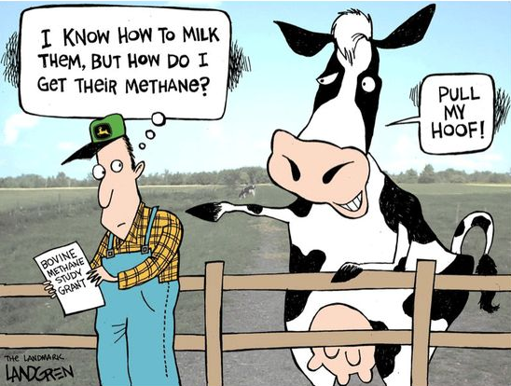
IT NEVER RAINS IN CALIFORNIA, BUT *****
California Enacts New “Cow Fart Tax” On Methane Emissions

Slide 120
“The laws of a state
change with
the changing times.”

Slide 121
Aeschylus
Seven Against Thebes, 467 B.C.

Slide 122
VISIT OUR WEBSITE FOR MORE
EMPLOYMENT LAW INFORMATION
www.amfdayton.com
EMPLOYMENT LAW
WORKERS’ COMPENSATION
OSHA
WAGE-HOUR
NLRB
DISCRIMINATION
COLLECTIVE BARGAINING
EMPLOYMENT LITIGATION
Aggressive, Responsive,
Cost Effective Representation

